Slide 1
GNR 607 Programming Assignment Presentation
Team Members:
Aminur Hossain (ID: 24D1384)
Amartya Ray (ID: 24D1383)

Slide 2
Problem Statement
Problem No 22
Objective:
Given a multiband image of N bands, compute principal components and generate the approximate version of the input image by performing inverse principal component transform using 2, 3, ..., N-1 components.
Input Data:
Dataset: 1 subset image taken from a Landsat-8 satellite full scene image
Bands: 7 bands (for the Mumbai scene)
LC08_L1TP_148047_20180423_20180502_01_T1.tar.gz

Slide 3
Procedure
Steps to Solve Problem
Load the Multiband Image:
Import the Landsat-8 image with 7 bands for the Mumbai scene.
Compute Principal Components (PCA):
Perform Principal Component Analysis (PCA) on the 7-band image to reduce dimensionality.
Reconstruction Using 2, 3, ..., N-1 Principal Components:
Reconstruct the image using inverse PCA with 2, 3, 4, 5, and 6 components to generate approximate images.
Comparison:
Compare the quality of reconstructed images using various quality metrics such as PSNR and SSIM to evaluate how much detail is retained with fewer components.
Visualization:
Display the original image alongside the reconstructed versions with different numbers of components for a visual comparison.

Slide 4
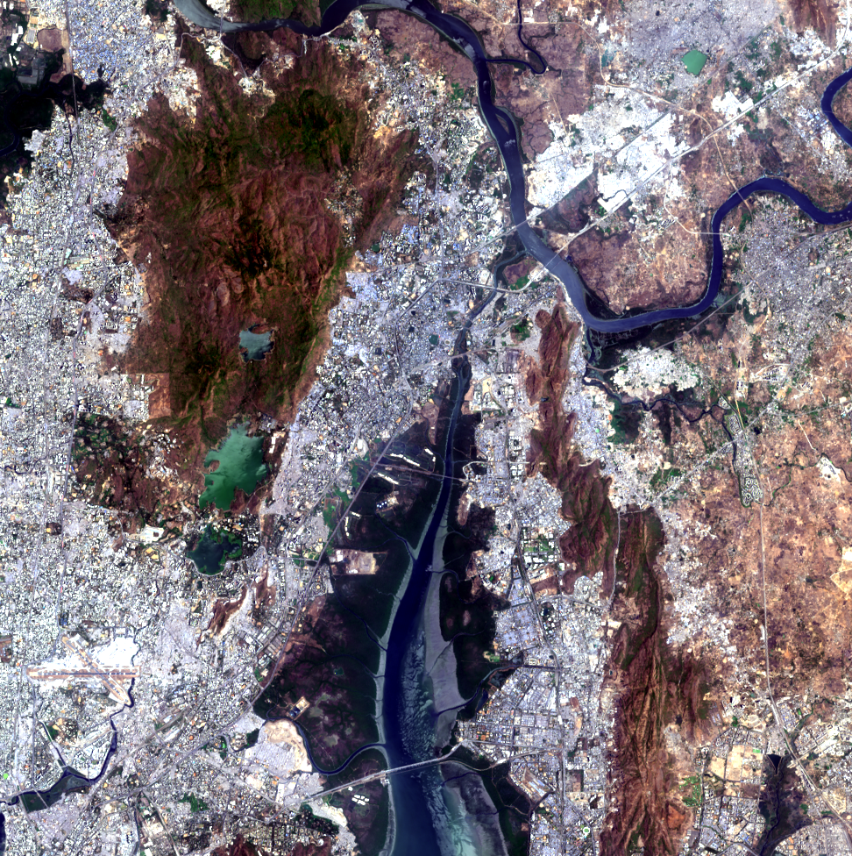
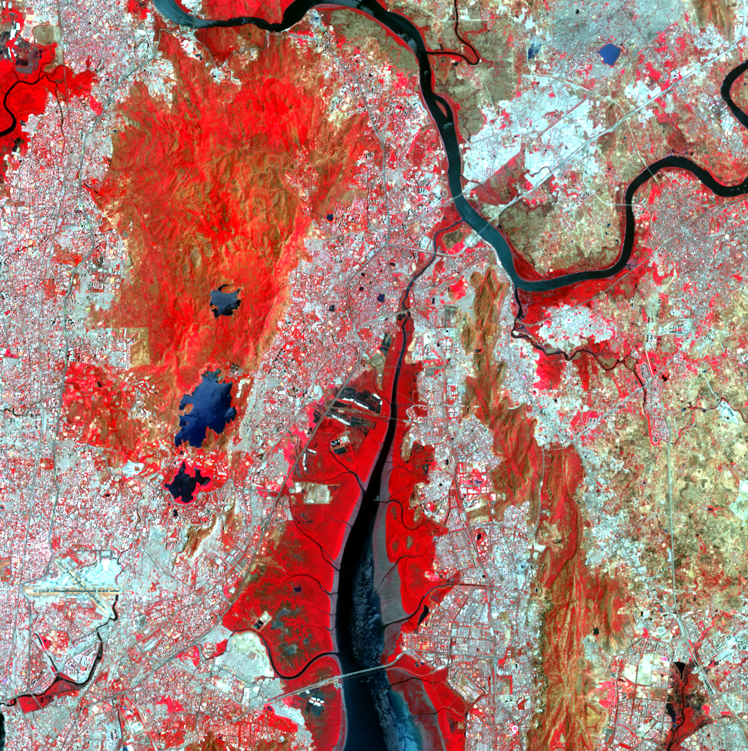
Input Images
Original RGB image
Original image in TCC

Slide 5
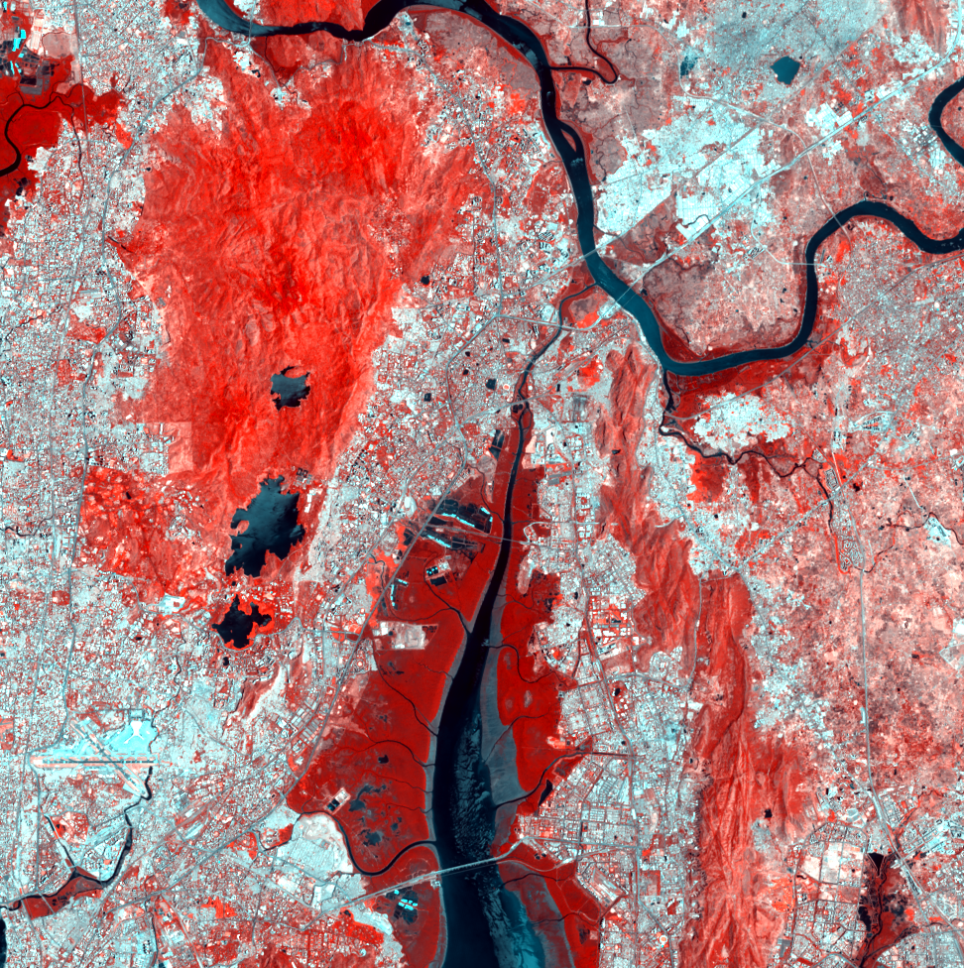
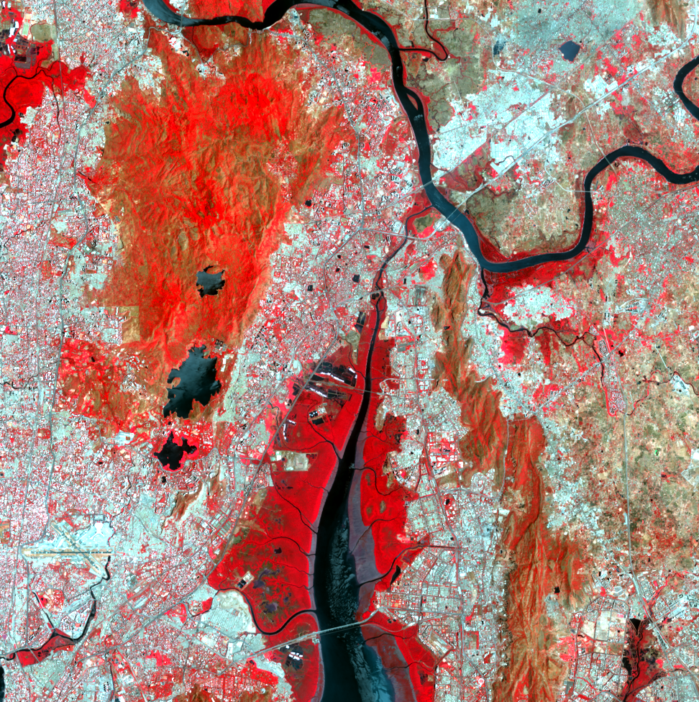
Reconstruction Results
Reconstructed image with 1st 2 PCs; PSNR – 42.37
Reconstructed image with 1st 3 PCs; PSNR – 53.18

Slide 6


Reconstruction Results
Reconstructed image with 1st 4 PCs; PSNR – 56.42
Reconstructed image with 1st 5 PCs; PSNR – 64.12

Slide 7

Reconstruction Results
Reconstructed image with 1st 6 PCs; PSNR – 73.59
Reconstructed image with all 7 PCs; original image

Slide 8
Statistical Results
PSNR – Peak Signal to Noise Ratio
SSIM – Structural Similarity Index Measure

Slide 9
Code Snippet
#importing packages
!pip install rasterio
import numpy as np
import rasterio
from rasterio.plot import show
import matplotlib.pyplot as plt
import cv2
import numpy as np
from skimage.metrics import structural_similarity as ssim
# Data preprocessing
def read_multiband_image(file_path):
with rasterio.open(file_path) as src:
bands = src.read()
meta = src.meta
return bands, meta
def write_image(file_path, image, meta):
with rasterio.open(file_path, 'w', **meta) as dest:
dest.write(image)

Slide 10
Code Snippet
def normalize_data(bands):
# Reshape bands to (num_bands, height * width)
num_bands, height, width = bands.shape
reshaped_bands = bands.reshape(num_bands, height * width)
# Standardize each band
mean = reshaped_bands.mean(axis=1, keepdims=True)
std = reshaped_bands.std(axis=1, keepdims=True)
normalized_bands = (reshaped_bands - mean) / std
return normalized_bands.reshape(num_bands, height, width), mean, std

Slide 11
Code Snippet
def perform_pca(bands):
num_bands, height, width = bands.shape
reshaped_bands = bands.reshape(num_bands, height * width).T
# Compute covariance matrix
covariance_matrix = np.cov(reshaped_bands, rowvar=False)
# Compute eigenvalues and eigenvectors
eigenvalues, eigenvectors = np.linalg.eigh(covariance_matrix)
# Sort eigenvalues and eigenvectors in descending order
idx = np.argsort(eigenvalues)[::-1]
eigenvalues = eigenvalues[idx]
eigenvectors = eigenvectors[:, idx]
# Project the data onto the eigenvectors
principal_components = np.dot(reshaped_bands, eigenvectors)
return eigenvectors, principal_components, (num_bands, height, width), eigenvalues

Slide 12
Code Snippet
def inverse_pca_and_reconstruct(eigenvectors, principal_components, shape, num_components, mean, std):
# Select the top num_components eigenvectors
selected_eigenvectors = eigenvectors[:, :num_components]
# Select the corresponding principal components
selected_components = principal_components[:, :num_components]
# Reconstruct the image
reconstructed = np.dot(selected_components, selected_eigenvectors.T)
reconstructed = reconstructed.T
# De-normalize the reconstructed data
num_bands, height, width = shape
reconstructed = reconstructed.reshape(num_bands, height * width)
reconstructed = (reconstructed * std) + mean
reconstructed = reconstructed.reshape(num_bands, height, width)
return reconstructed

Slide 13
Code Snippet
# Function to calculate PSNR
def calculate_psnr(original, compressed):
mse = np.mean((original - compressed) ** 2)
if mse == 0: # MSE is zero means no noise is present in the signal, PSNR is infinite
return float('inf')
max_pixel = 65536.0
psnr_value = 20 * np.log10(max_pixel / np.sqrt(mse))
return psnr_value
# Function to calculate SSIM
def calculate_ssim(original, compressed):
ssim_value = ssim(original, compressed, multichannel=True, data_range=65536)
return ssim_value

